Slide 1
Theories of Ego Network Homogeneity

Slide 2
Blau’s Macrostructural Theory

Slide 3
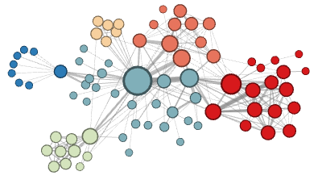
Why do your ego networks look they way they do?
The composition of your ego network is likely biased
  How are your ego networks biased?
    Some kinds of people are over-represented in your ego-network
    Some kinds of people are under-represented in your ego network
    The people who are over-represented are more likely to be similar to you
    The people who are under-represented are more likely to be dissimilar to you
      These last two things are the basis of homophily*
*McPherson, M., Smith-Lovin, L., & Cook, J. M. (2001). Birds of a feather: Homophily in social networks. Annual Review of Sociology, 27(1), 415-444.

Slide 4
Why do your ego networks look they way they do?
In what ways are your networks biased toward homophily?
  According to pretty much any social distinction we can think of
    Gender
    Race/Ethnicity
    Education
    Age
    Occupation/Income
  These are what Peter Blau called dimensions of association or parameters of social structure

Slide 5
Why do your ego networks look they way they do?
In what ways are your networks biased toward homophily?
  According to pretty much any social distinction we can think of
    Gender
    Race/Ethnicity
    Education
    Age
    Occupation/Income
  Some dimensions of association are categorical (no inherent ordering)
    Like race, gender identity, occupation, nationality
  These are called nominal parameters

Slide 6
Why do your ego networks look they way they do?
In what ways are your networks biased toward homophily?
  According to pretty much any social distinction we can think of
    Gender
    Race/Ethnicity
    Education
    Age
    Occupation/Income
  Other dimensions of association are continuous or ordinal (inherent ordering)
    Like age, education, income, net worth
  These are called graduated parameters

Slide 7

Why do your ego networks look they way they do?
Why are your ego networks biased toward homophily?
  One obvious source of bias is what has been called* choice homophily
    You like to hang out with people who are similar to you (regardless)
  One non-obvious source of bias is what has been called* induced homophily
    The social context (nation, state, organization) where you reside determines the people who are available for you to hang out with
*McPherson, J. M., & Smith-Lovin, L. (1987). Homophily in voluntary organizations: Status distance and the composition of face-to-face groups. American Sociological Review, 370-379.
Peter Blau (1918 - 2002)

Slide 8
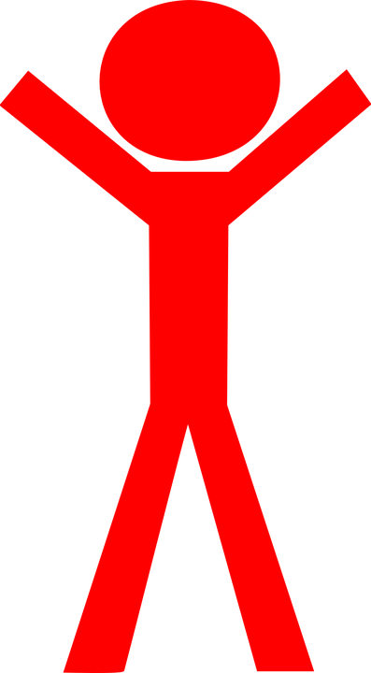
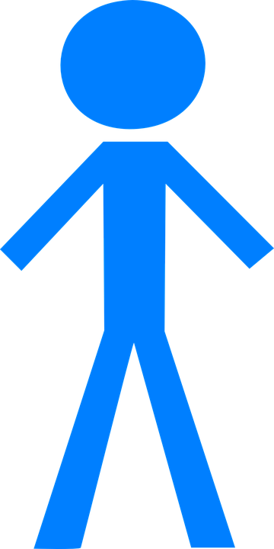
Why do your ego networks look they way they do?
The World
Your ego network
Peter Blau (1918 - 2002)
Unbiased
Biased

Slide 9
Why do your ego networks look they way they do?
The World
Your ego network
Peter Blau (1918 - 2002)
Unbiased
Biased

Slide 10
Why do your ego networks look they way they do?
The World
Your ego network
Peter Blau (1918 - 2002)
Unbiased
Biased

Slide 11
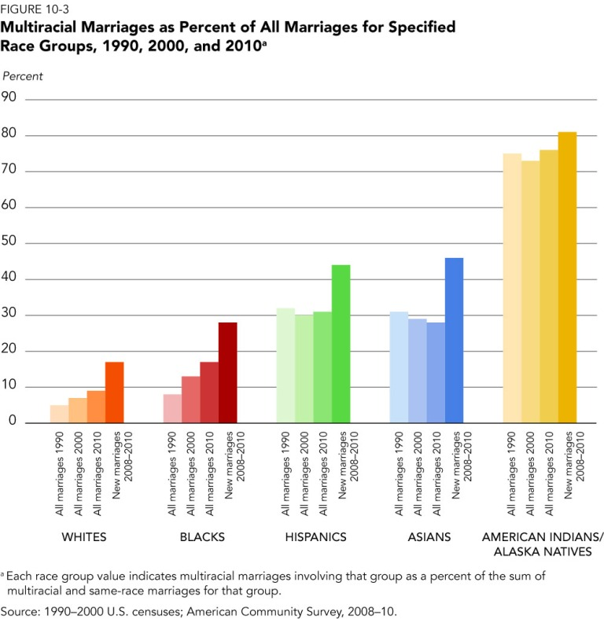
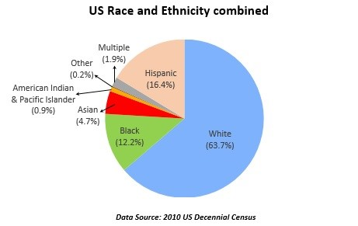
Blau’s Rules: Group Size Effects
If a categorical dimension divides the population into two or more groups:
  Rule 1: Members of numerically smaller groups will be more likely to have relations with outgroup (different group) members
  Rule 2: Members of numerically larger groups will be more likely to have relations with ingroup (same group) members
These are called group size effects

Slide 12
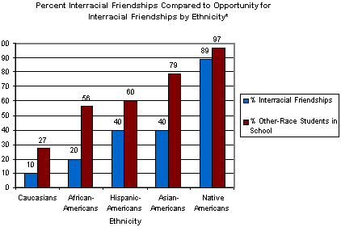
Blau’s Rules: Group Size Effects
If a categorical dimension divides the population into two or more groups:
  Rule 1: Members of numerically smaller groups will be more likely to have relations with outgroup (different group) members
  Rule 2: Members of numerically larger groups will be more likely to have relations with ingroup (same group) members
These are called group size effects
Source: Joyner, K. & Kao, G. (2000). School racial composition and adolescent racial homophily. Social Science Quarterly, 81, 810-825.

Slide 13

Blau’s Rules: Multiform Heterogeneity Effects
If people belong to multiple correlated categorical dimensions:
  Rule 3: Preferences for association in one dimension lead to biases in social contacts on the other dimension
This is called the Multiform Heterogeneity Effect
Example:
  In the U.S. there are systematic correlations between religion and race
  Ego networks biased by race (choice homophily) will also be biased by religion
  Even if people don’t have preferences for the religion of their contacts (Induced homophily)

Slide 14
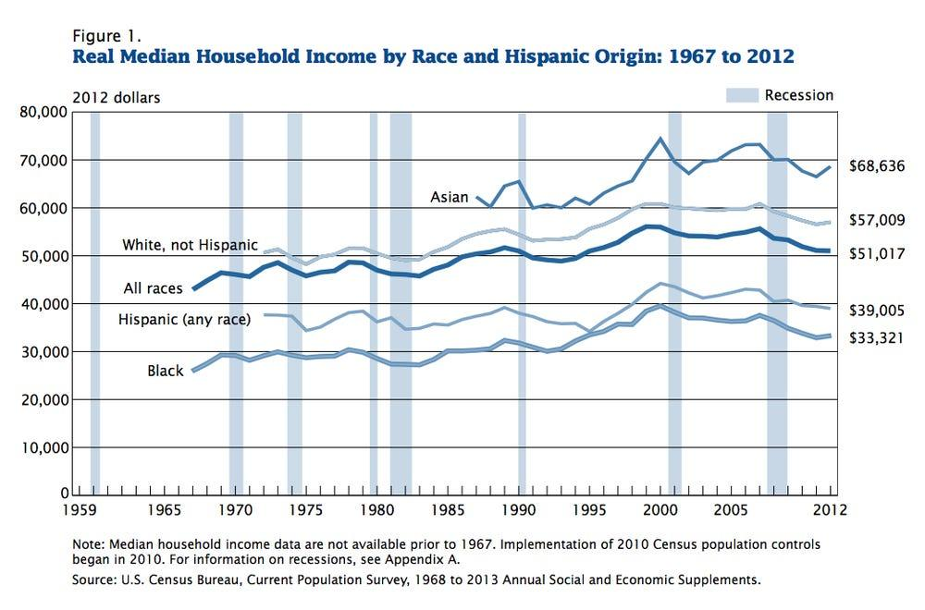
Blau’s Rules: Multiform Heterogeneity Effects
Rule 3 (multiform heterogeneity) applies to any correlation between dimensions of association regardless of whether they are categorical or continuous
  Categorical-Categorical (e.g., Race and Religion)
    Networks biased by religion will be biased by race
  Categorical-Continuous (e.g., Race and Income)
    Networks biased by race will be biased by income
  Continuous-Continuous (e.g., Age and Income)
    Networks biased by age will be biased by income

Slide 15
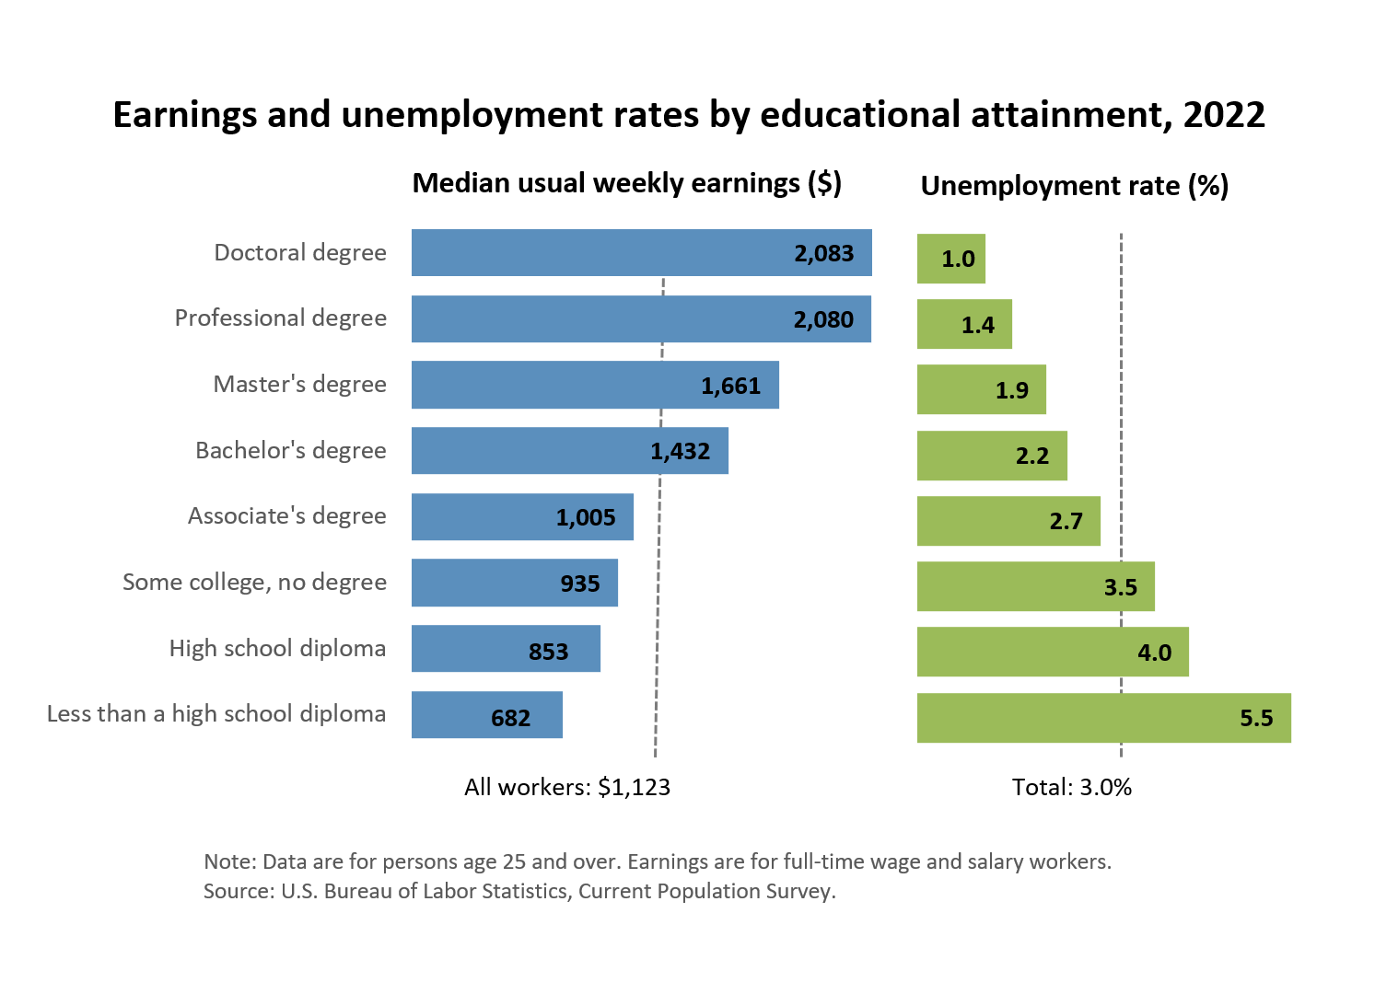
Blau’s Rules: Multiform Heterogeneity Effects
Rule 3 (multiform heterogeneity) applies to any correlation between dimensions of association regardless of whether they are categorical or continuous
  Categorical-Categorical (e.g., Race and Religion)
    Networks biased by religion will be biased by race
  Categorical-Continuous (e.g., Race and Income)
    Networks biased by race will be biased by income
  Continuous-Continuous (e.g., Age and Income)
    Networks biased by age will be biased by income

Slide 16
Feld’s Focus Theory

Slide 17
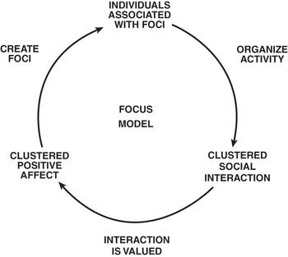
Focused organizations of social ties
One observation:
  Often social relations are organized around “circles,” or “common activities”
  These foci determine which relations show up in people’s networks
What is a focus?
  “ a social, psychological, legal, or physical entity around which joint activities are organized (e.g., workplaces, voluntary organizations, hangouts, families, etc.” (Feld 1981: 1016)

Slide 18
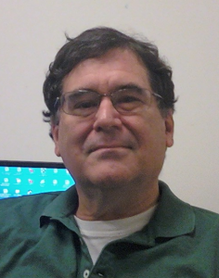
Why do your ego networks look they way they do?
Church
Family
School
You
Scott Feld
Unbiased!

Slide 19
Why do your ego networks look they way they do?
Church
Family
School
You
Scott Feld
Unbiased!

Slide 20
Why do your ego networks look they way they do?
The typical settings within which you interact as reference for bias:
  Feld Rule: If the settings within which you interact are biased towards a particular categorical or continuous dimension of association your ego-network will reflect that bias
    Feld referred to these settings as social foci
    Therefore, this is the called the focus effect
      Foci make homophily happen via segregation
    Conversely,
      Desegregated foci reduce homophily
Scott Feld

Slide 21

Focused organizations of social ties
This suggests two new mechanisms for where ties come from:
b
a
c
Ego
h
d
From circle to relation
g
e
f
From common activity to relation

Slide 22
Focused organizations of social ties
Foci vary around several dimensions
  Constraint
    Time and energy that they require
  Size
    Some foci are big others are small
Foci emerge from pre-existing relations
  Friends form clubs, participate in common activities
Multiple intersecting foci
  “Cross-cutting” circles
  Homophily at the ego-network level may be the result of constraining overlapping foci
b
a
c
Ego
h
d
g
e
f

Slide 23
Marden’s Theory of Ego Network Diversity

Slide 24
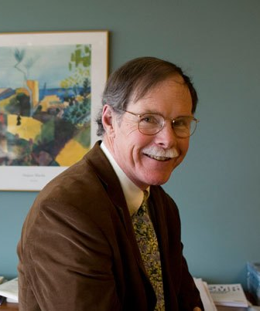
Why do your ego networks look they way they do?
The World
Your ego network
Small
Large
Peter Marsden
More biased
Less Biased

Slide 25
Why do your ego networks look they way they do?
Overall, larger ego networks should be more diverse
  Regardless of preferences for choice homophily
    At some point you run out of in-group alters!
But this effect should depend on group size effects
  In general, minorities should get more “bang from their buck” (in terms of diversity) from network size
    Can you tell why?
Peter V. Marsden

Slide 26
Why do your ego networks look they way they do?
Overall, larger ego networks should be more diverse
  Regardless of preferences for choice homophily
    At some point you run out of in-group alters!
But this effect should depend on group size effects
  In general, minorities should get more “bang from their buck” (in terms of diversity) from network size
    Can you tell why?
A
B

Slide 27

Why do your ego networks look they way they do?
A
B

Slide 28
Ego networks: Some Propositions (Marsden 1987)
The larger the ego network:
  The more diverse, less homophilous, less clustered
The smaller the ego network:
  More clustered , less diverse, more homophily
The more diverse the ego network:
  Less homophily
The higher average tie strength:
  The more clustering, less diversity, more homophily
The more proportion kin:
  The more homophily, less diversity, more clustering
b
a
c
Ego
h
d
g
e
f

